Slide 1
STORAGE CLASSES
UNIT-5
PROGRAMMING IN C
Prepared by
M.DHARANI AP/CSE

Slide 2
STORAGE CLASS
The storage classes define the visibility (scope) and the lifetime of any function/ variable within a C program.
Every identifier should be declared with data type as well as storage class.
If the storage class is not specified in a declaration statement, the compiler assumes default storage class depending upon the scope in which the declaration is made.

Slide 3
Types
● Automatic Storage Class
● External Storage Class
● Static Storage Class
● Register Storage Class
● typedef

Slide 4
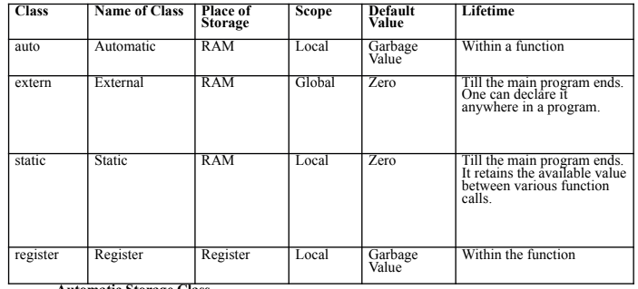
Comparison

Slide 5
Automatic Storage Class
It is also known as the auto storage class, and it acts as the default storage class for all the variables that are local in nature.
For example,
{
int month;
auto int month;
}

Slide 6
Features
The allocation of memory for these variables occurs automatically during the runtime.
The visibility of these variables is also limited to that block in which we are defining them.
Stored in main memory.
scope of auto variable is local.
Auto variables will have garbage value.
Syntax: auto datatype var1, var2,.....varn;
Example: auto float x,y;

Slide 7
Example Program using auto:
#include<stdio.h>
#include<conio.h>
void main()
{
autointa=10;
clrscr();
printf(“a is %d”, a);
getch();
}
Output:
a is 10

Slide 8
External Storage Class
It is also known as the extern storage class
Global variable which is visible to all the files present in a program.
When using the extern storage class, we cannot initialize the variable.
Features
The variables that are declared as extern have no allocation of memory.
An external integral type’s default initial value is going to be 0, or else it is null.

Slide 9
Features Conti..
The external variable can be initialized multiple times, but we can only initialize it a single time.
External variables are declared out of main() function.
The variables can be accessed in main function and inside the user defined functions.
Syntax: extern datatype var1, var2,...varn;
Example: extern int a;

Slide 10
Example Program:
#include<stdio.h>
#include<conio.h>
externint a=100;
void main()
{
printf(“a is %d”, a);
}
Output:
a is 100

Slide 11
Static Storage Class
when a local variable is made static, it allows the variable to maintain the values that are available between various function calls.
This type of storage class gives an instruction to a compiler to keep the given local variable around during the program’s lifetime- instead of creating it and then destroying it every time it comes into a scope and goes out of it.

Slide 12
Features
We can declare the very same static variable multiple times, but we can only assign it a single time.
The initial value of a static integral variable, by default, is 0. Else, it is null.
Default value of static variable is zero.
Stored in main memory.
Scope of static variable is local and global scope.
Syntax: static datatype var1, var2,......varn;
Example: static inta,b;

Slide 13
Example Program:
#include<stdio.h>
#include<conio.h>
void main()
{
static int a;
printf(“a is %d”, a);
}
Output:
a is 0

Slide 14
Register Storage Class:
The register storage class is used for defining the local variables that must be stored in any register, and not in RAM.
Maximum size of this variable is equal to that of the register size.
Features
Its access time is comparatively much faster than that of the automatic variables.
The default initial value of any given register local value will always be 0.
We use the register keyword for the variable that must be stored in a CPU register.

Slide 15
Syntax: register datatype var1, var2,....varn;
Example: register int a=10;
Example Program:
#include<stdio.h>
#include<conio.h>
void main()
{
register int a=10;
printf(“a is %d”, a);
}
Output:
a is 10

Slide 16
Typedef Storage class:
Used to create a new name for existing datatype.
Syntax:
typedef existing_type new_name;
Features:
● Provides a meaningful way of declaring the variables.
● Increases the readability of the program.
● A complex declaration can be reduced to short and meaningful declaration.
● typedef is widely used while dealing with structures.

